Slide 1

AUTOMATING HR PROCESSES WITH WATSONX ORCHESTRATE
PRESENTED BY:
Mageshprabu G

Slide 2
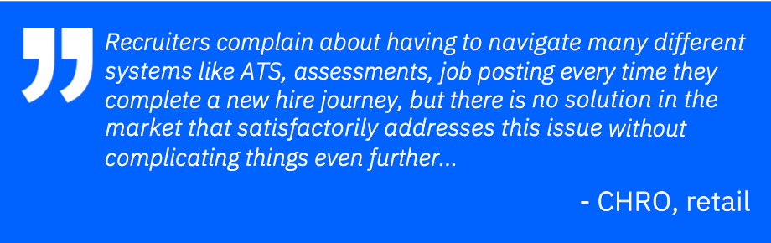
Problem Statement :
Challenges :
Requisition posting -->Review and update job requisition with hiring manager (1-3 hours/requisition)
Candidate sourcing -->Review inbound applications based on keywords and exec summary
Interview & assessments -->Screen candidates based on assessment responses and message hiring managers for review (10-20 mins/candidate)

Slide 3
Watsonx Ochestrate and its role In Recruitment :

Slide 4
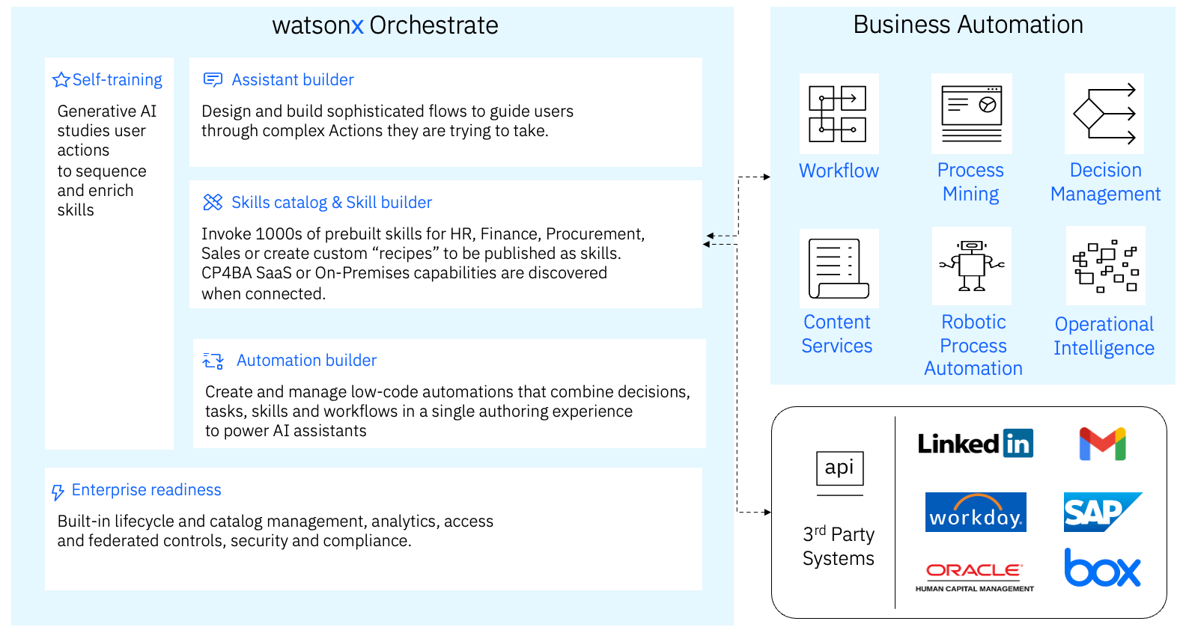
Architecture of Orchestrate

Slide 5
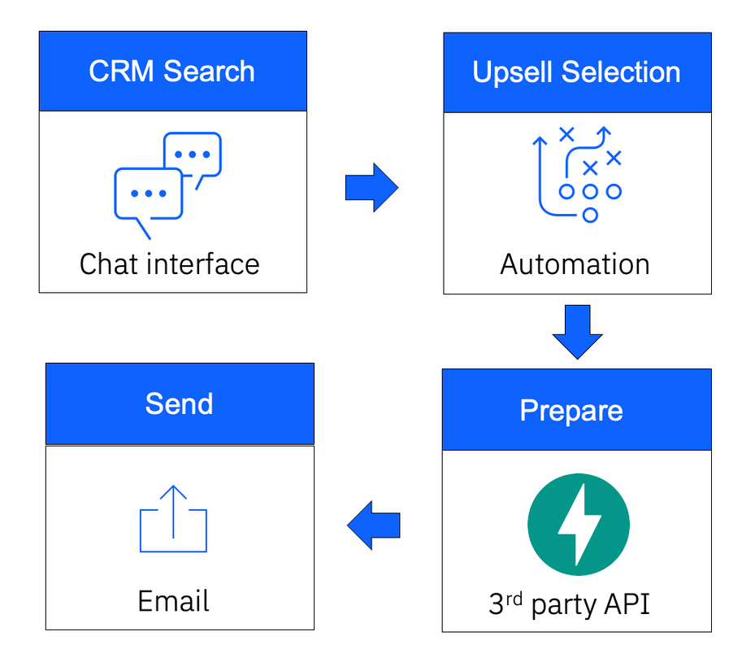
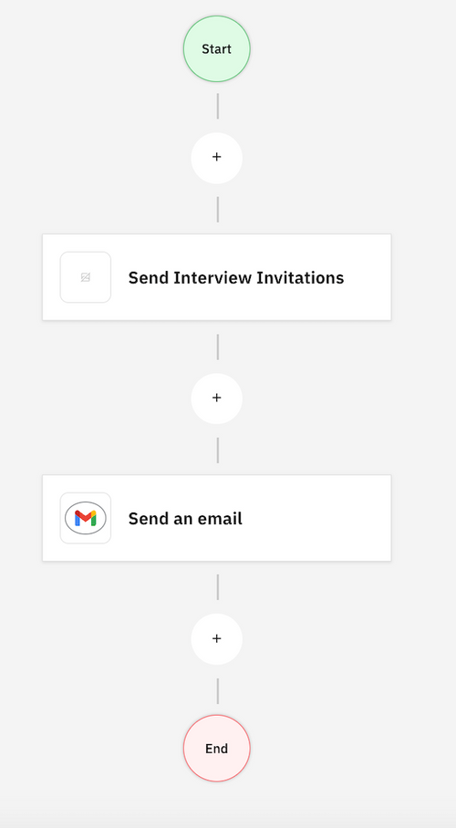
Workflow of Orchestrate

Slide 6
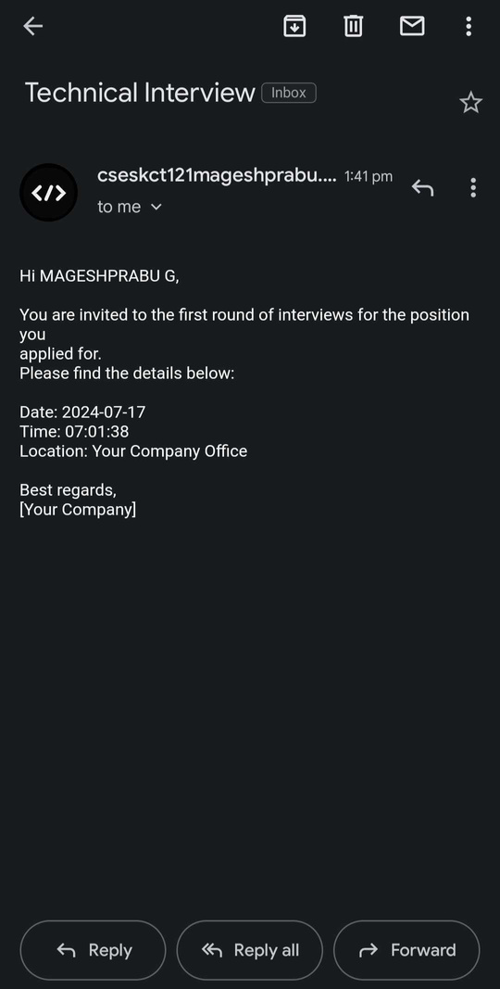
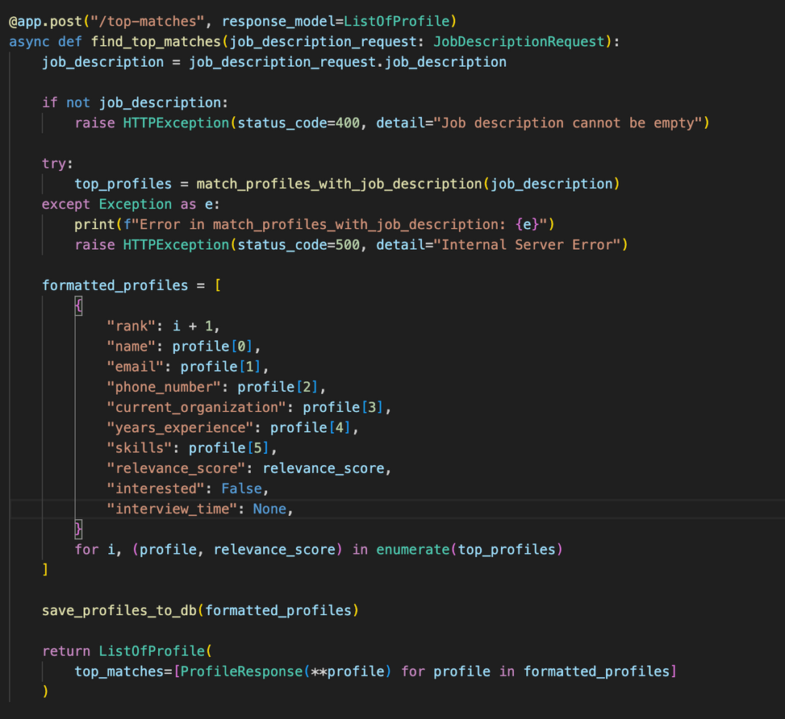
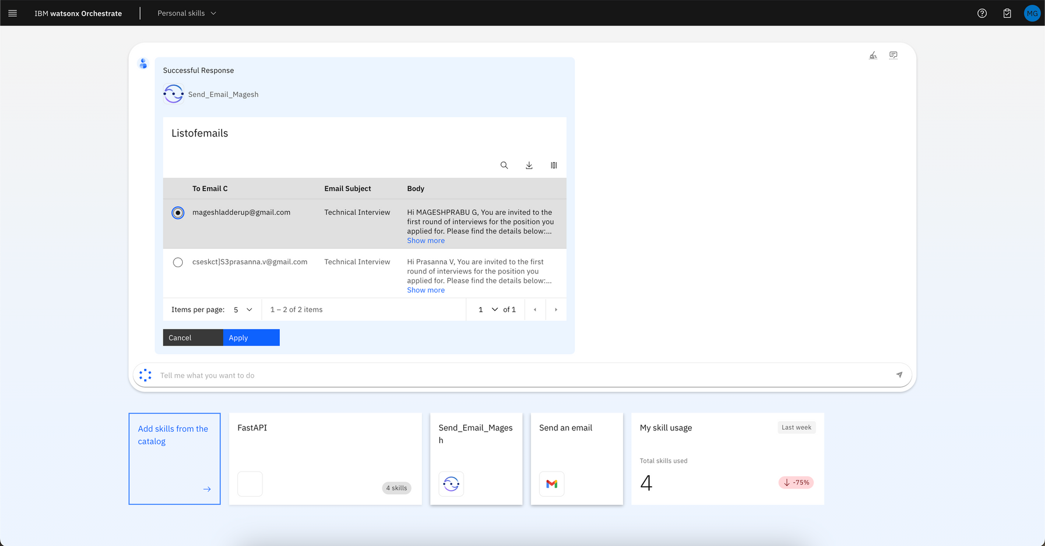
Workflow of Orchestrate

Slide 7
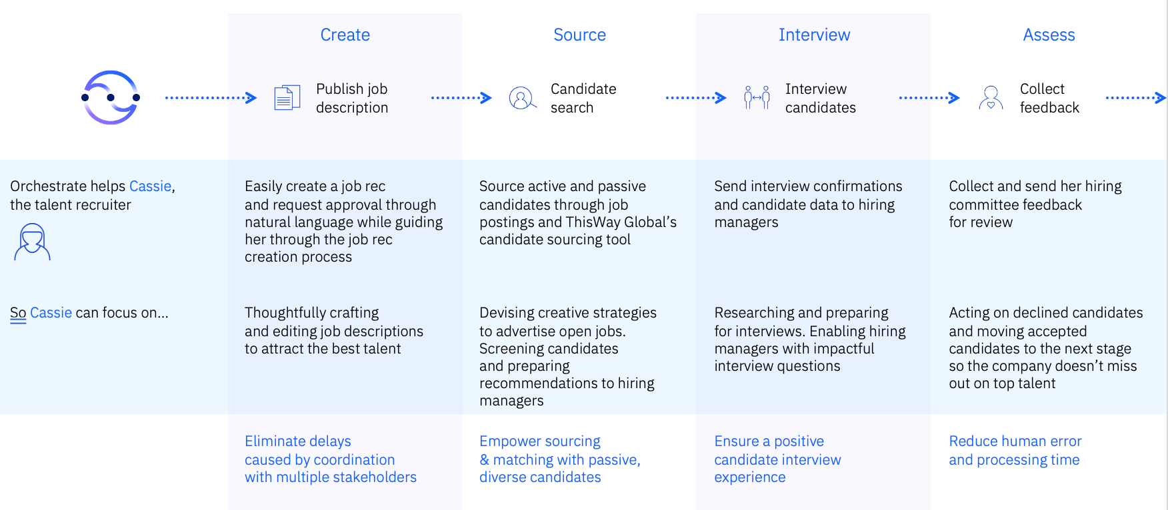
Future scope
Generate a list of questions to prepare the interviews (based on the job description / candidate experiences)
Create UI for candidates to take the assessment.

Slide 8
Learnings
AI Fundamental
Watsonx.ai.sales foundation
Watsonx.ai Level 2
IBM watsonx.ai for Technical Sales Level 3
AI for Business
Watsonx Orchestrate Sales Foundation
Watsonx Orchestrate Level 2
Watsonx Orchestrate for Sales Level 3
Watsonx Orchestrate for Technical Sales Level 3
Python
Beautifulsoup for web crawling
FastAPI

Slide 9
Watsonx Challenge: Agriculture Disease Prevention
Data Collection:
Collected data on various agricultural diseases.
Gathered information by specifying disease names, crop names, and recommended remedies.
Web Crawling:
Utilized Beautiful Soup for web crawling.
Extracted data and stored responses in a .csv file.
Sample Questions and Responses:
Generated sample questions and corresponding responses related to agricultural diseases.
Outcome:
Successfully compiled a comprehensive dataset to assist in the prevention and management of agricultural diseases.

Slide 10
Thank you

